Slide 1
Matter
Chapter 2

Slide 2
Classifying Matter
Section 1

Slide 3
Matter
Matter: anything that has mass and takes up space (this includes air)
Chemistry: the study of matter
Can be classified as an element, compound or mixture

Slide 4
Elements
Elements: substances that cannot be broken down into simpler substances by chemical means
Made entirely of the same atom
112 known atoms
90 of those occur naturally
less than 40 of those can be found naturally in elemental form
Hydrogen, copper, gold, magnesium, lead, oxygen, nitrogen, helium, etc.
Elements cannot be separated into other things!

Slide 5
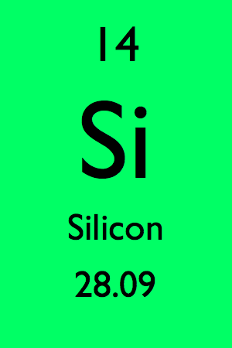
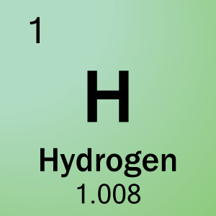
Elements
Elements are represented by a 1-2 letter symbol
The first must always be a capital letter, and the second (if present, is lower case).
C: Carbon
He: Helium
Capitalization is VERY important when writing the symbol for an element
CO = carbon monoxide
Co = cobalt

Slide 6
Molecules
Molecule: two or more atoms bonded together
Smallest unit of a substance that will behave like the substance
water, carbon dioxide, ammonia, glass, alcohol, and limestone

Slide 7
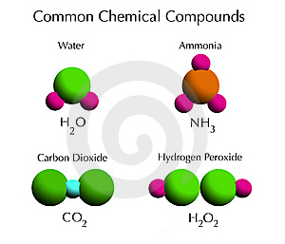
Compounds
Compound: substance made up of atoms of different elements (two or more elements chemically combined)
Compounds can be broken down into other things
This happens with a chemical change

Slide 8
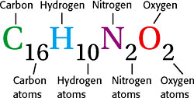
Compounds
Compounds are represented by a chemical formula – symbols of the elements in them, and a subscript
A subscript shows how many there are of that atom in the compound
If there is no subscript number then 1 is implied, but you don’t write 1!

Slide 9
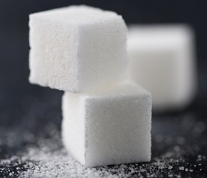
Pure Substances
Pure Substance: matter that has a fixed composition (make-up) and definite properties
Elements and compounds are pure substances, mixtures are not

Slide 10
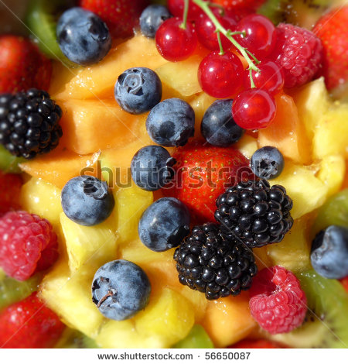
Mixtures
Mixture: Compounds and/or elements mixed together but not bonded together.
Substances that make up a mixture keep most of their own properties
Mixtures can be separated by simple physical means
Iron and aluminum could be separated with a magnet, coffee grounds and water can be separated with a filter

Slide 11
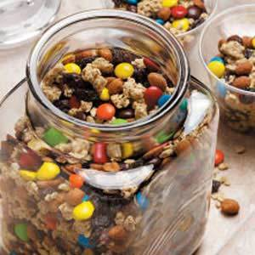
Mixtures
Can be heterogeneous or homogeneous
Heterogeneous: different throughout or chunky, separation can be seen
granite, orange juice with pulp, Italian dressing
Homogeneous: the same throughout, no separation can be seen
metal alloys, air around you, milk and saltwater

Slide 12
Properties of Matter
Section 2

Slide 13
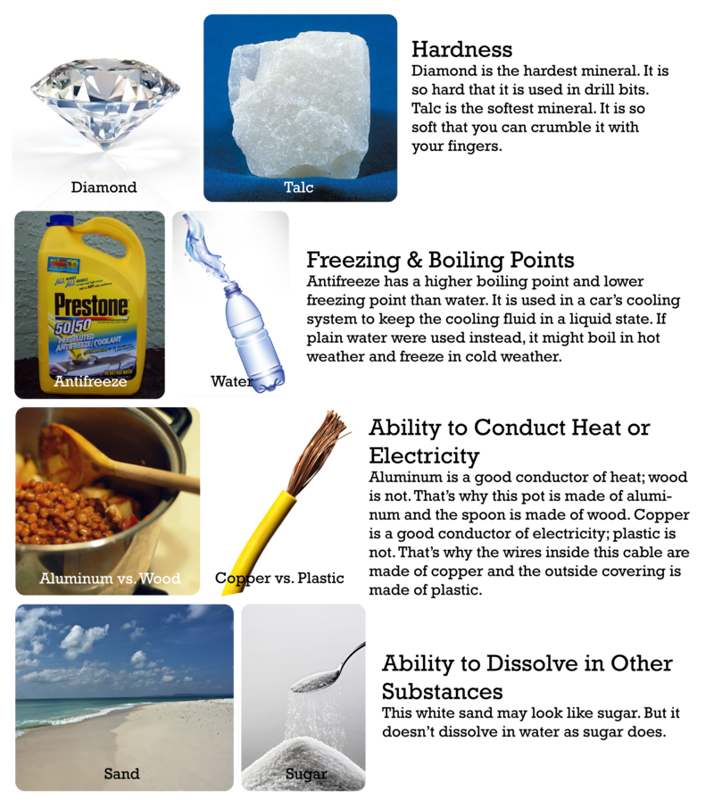
Physical Properties
Any property that can be tested without changing the identity of the substance.
For Example: mass, weight, density, volume, color, shape, texture, melting point, and boiling point.
Helps determine the use of the substance
Aluminum is used in foil because it is lightweight, but durable and flexible

Slide 14
Density
Density: ratio of mass to volume of an object.
D = m / v (density = mass / volume)
Density is a physical property
Measured in g/mL (grams per milliliter), or g/cm³ (grams per centimeters cubed)
Density of a pure compound or element is a constant (it never changes)
Pure water is always 1.0 g/mL

Slide 15
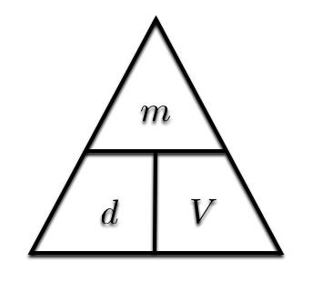
Density
D = m / v
If an object has a mass of 24 g and a volume of 48 mL, what is it’s density?
D = 24 g / 48 mL
= .5 g/mL
If an object has a density of 1.5 g/mL, and it’s volume is 4 mL. What is it’s mass?
1.5 g = m / 4 mL
= 6 g

Slide 16
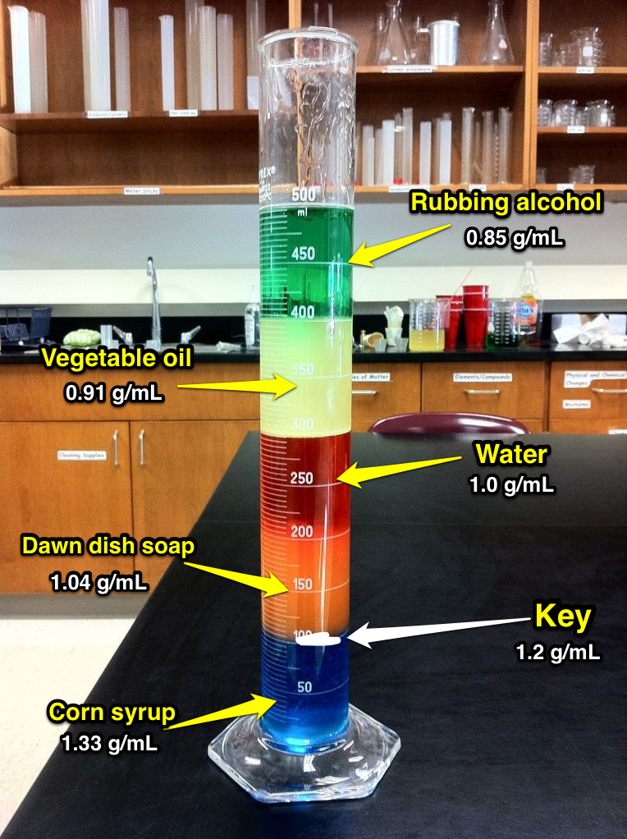
Density
Less dense objects float in more dense objects.

Slide 17
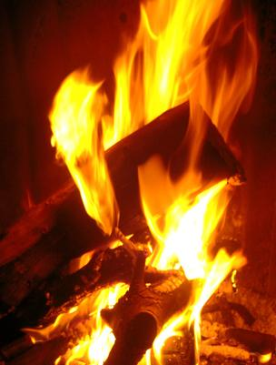
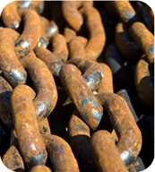
Chemical Properties
Any property that can only be tested by changing the chemical make-up of the substance.
Flammability, chemical reactivity, and ability to rust.

Slide 18
Changes of Matter
Section 3

Slide 19
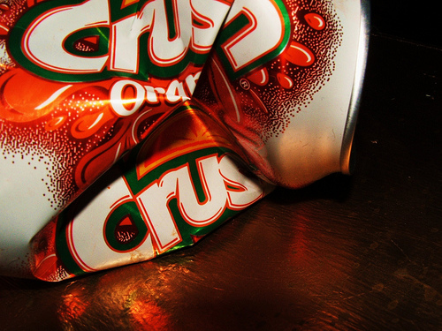
Physical Changes
Affects one or more physical properties of a substance without changing the identity of the substance
Melting, cutting, crushing

Slide 20
Chemical Changes
Happens when one or more substances are changed into entirely new substances with different properties
Evidence of a chemical change
bubbling, light, heat, color changes, an odor or a sound

Slide 21
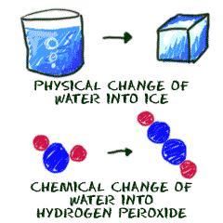
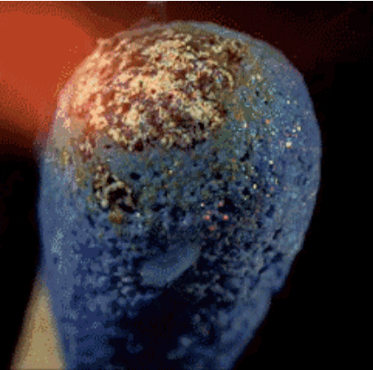
Chemical Changes
You can tell a chemical reaction has occurred if the products are different from the reactants!
If there is no change it is NOT a reaction!
e.g. ice melting is NOT a reaction, it is a physical change!

Slide 22
Physical or Chemical Change?
cutting a piece of ice in half
physical change
activating an instant ice pack (make it cold)
chemical change
melting ice
physical change
baking flour, sugar, egg and water together
chemical change

Slide 23
Separating Mixtures
Depending on the shape and size, you may can use physical properties to separate mixtures
use a filter, or a centrifuge
Solutions require distillation
boiling substances off one at a time)
Chemical properties could also be used to separate mixtures

Slide 24
Separating Compounds
Physical properties CANNOT be used to separate a compound
If it’s made of molecules, chemical properties CAN be used to separate it.
Water can be separated into hydrogen and oxygen gas by electrolysis (a chemical change)

